Slide 1
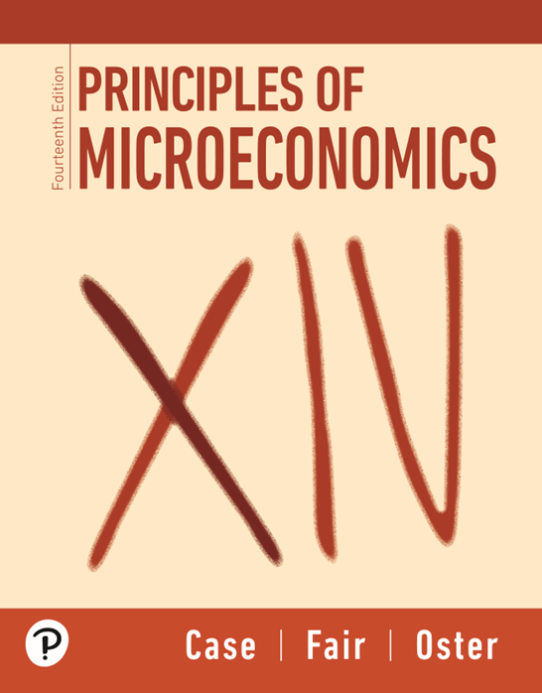

Principles of Microeconomics
Fourteenth Edition
Part 1
Introduction to Economics
Chapter 1
The Scope and Method of Economics
Copyright © 2026, 2020, 2016 Pearson Education, Inc. All Rights Reserved
Notes:
If this PowerPoint presentation contains mathematical equations, you may need to check that your computer has the following installed:
1) MathType Plugin
2) Math Player (free versions available)
3) NVDA Reader (free versions available)

Slide 2
Chapter 1 The Scope and Method of Economics
economics The study of how individuals and societies choose to use the scarce resources that nature and previous generations have provided.
The key word in the definition is choose.
Economics is a behavioral, or social, science.
Economics is the study of how people make choices.

Slide 3
Why Study Economics?
To Learn a Way of Thinking
Economics has three fundamental concepts:
  Opportunity Cost
  Marginalism
  Efficient Markets

Slide 4
To Learn a Way of Thinking (1 of 3)
Opportunity Cost
opportunity cost The best alternative that we forgo, or give up, when we make a choice or decision.
scarce Limited.

Slide 5
To Learn a Way of Thinking (2 of 3)
Marginalism
marginalism The process of analyzing the additional or incremental costs or benefits arising from a choice or decision.

Slide 6
To Learn a Way of Thinking (3 of 3)
Efficient Markets—No Free Lunch
efficient market A market in which profit opportunities are eliminated almost instantaneously.
The study of economics teaches us a way of thinking and helps us make decisions.

Slide 7

Economics in Practice (2 of 4)
Majoring in Economics Makes You Less Vulnerable to a Recession!
It is well known that economics is, along with engineering, one of the majors with the highest wage premia.
Recent work has also shown that majors like economics are less hurt by graduating in a recession than sociology or journalism.
Critical Thinking
What types of jobs do economics majors typically go into?

Slide 8
To Understand Society
The study of economics is an essential part of the study of society.

Slide 9
To Be an Informed Citizen
To be an informed citizen requires a basic understanding of economics.

Slide 10
The Scope of Economics
Microeconomics and Macroeconomics
microeconomics The branch of economics that examines the functioning of individual industries and the behavior of individual decision-making units—that is, firms and households.
macroeconomics The branch of economics that examines the economic behavior of aggregates—income, employment, output, and so on—on a national scale.

Slide 11
Table 1.1 (1 of 2)
Examples of Microeconomic and Macroeconomic Concerns
Division of Economics | Production | Prices | Income | Employment
Microeconomics | Production/output in individual industries and businesses How much steel How much office space How many cars | Prices of individual goods and services Price of medical care Price of gasoline Food prices Apartment rents | Distribution of income and wealth Wages in the auto industry Minimum wage Executive salaries Poverty | Employment by individual businesses and industries Jobs in the steel industry Number of employees in a firm Number of accountants

Slide 12
Table 1.1 (2 of 2)
Examples of Microeconomic and Macroeconomic Concerns (Continued)
Division of Economics | Production | Prices | Income | Employment
Macroeconomics | National production/output Total industrial output Gross domestic product Growth of output | Aggregate price level Consumer prices Producer prices Rate of inflation | National income Total wages and salaries Total corporate profits | Employment and unemployment in the economy Total number of jobs Unemployment rate

Slide 13
Table 1.2 (1 of 4)
The Fields of Economics
Behavioral economics
  Do aggregate household savings increase when we automatically enroll people in savings programs and let them opt out as opposed to requiring them to sign up?
Comparative economic systems
  How does the resource allocation process differ in market versus command and control systems?
Econometrics
  What inferences can we make based on conditional moment inequalities?
Economic development
  Does increasing employment opportunities for girls in developing nations increase their educational achievements?

Slide 14
Table 1.2 (2 of 4)
The Fields of Economics (continued)
Economic history
  How did the growth of railroads and improvement in transportation more generally change the U.S. banking systems in the nineteenth century?
Environmental economics
  What effect would a tax on carbon have on emissions? Is a tax better or worse than rules?
Finance
  Is high frequency trading socially beneficial?
Health economics
  Do co-pays by patients change the choice and use of medicines by insured patients?

Slide 15
Table 1.2 (3 of 4)
The Fields of Economics (continued)
The history of economic thought
  How did Aristotle think about just prices?
Industrial organization
  How do we explain price wars in the airline industry?
International economics
  What are the benefits and costs of free trade? Does concern about the environment change our views of free trade?
Labor economics
  Will increasing the minimum wage decrease employment opportunities?

Slide 16
Table 1.2 (4 of 4)
The Fields of Economics (continued)
Law and economics
  Does the current U.S. patent law increase or decrease the rate of innovation?
Public economics
  Why is corruption more widespread in some countries than in others?
Urban and regional economics
  Do enterprise zones improve employment opportunities in central cities?

Slide 17
The Method of Economics
Economics deals with two kinds of questions: positive and normative.
positive economics An approach to economics that seeks to understand behavior and the operation of systems without making judgments. It describes what exists and how it works.
normative economics An approach to economics that analyzes outcomes of economic behavior, evaluates them as good or bad, and may prescribe courses of action. Also called policy economics.

Slide 18
Theories and Models (1 of 5)
model A formal statement of a theory, usually a mathematical statement of a presumed relationship between two or more variables.
variable A measure that can change from time to time or from observation to observation.
Ockham’s razor The principle that irrelevant detail should be cut away.

Slide 19
Theories and Models (2 of 5)
All Else Equal
ceteris paribus or all else equal A device used to analyze the relationship between two variables while the values of other variables are held unchanged.
Using the device of ceteris paribus is one part of the process of abstraction.
In formulating economic theory, the concept helps us simplify reality to focus on the relationships that interest us.

Slide 20
Theories and Models (3 of 5)
Expressing Models in Words, Graphs, and Equations
Graphs and equations capture the quantitative side of economic observations and predictions.

Slide 21
Theories and Models (4 of 5)
Cautions and Pitfalls
Economists are interested in cause and effect, but sorting out causality from correlation is not always easy.
post hoc, ergo propter hoc Literally, “after this (in time), therefore because of this.” A common error made in thinking about causation: If Event A happens before Event B, it is not necessarily true that A caused B.

Slide 22
Theories and Models (5 of 5)
Testing Theories and Models: Empirical Economics
empirical economics The collection and use of data to test economic theories.

Slide 23
Economic Policy (1 of 3)
Four criteria are important in judging economic outcomes:
  Efficiency
  Equity
  Growth
  Stability

Slide 24
Economic Policy (2 of 3)
Efficiency
efficiency In economics, efficiency means allocative efficiency. An efficient economy is one that produces what people want at the least possible cost.
Equity
equity Fairness.

Slide 25
Economic Policy (3 of 3)
Growth
economic growth An increase in the total output of an economy.
Stability
stability A condition in which national output is growing steadily, with low inflation and full employment of resources.

Slide 26
Economic Skills and Economics as a Career
We will explore economic principles that you will find very useful in understanding what is happening in the world of economics and business and in your everyday life.
Individuals, business managers, and government policymakers use economic principles to improve how they make important decisions.
Whether or not you pursue a career in economics, you can still benefit from the skills learned by taking economics classes.

